Slide 1
Toll Parking Java API
Marius Ghita

Slide 2
Requirements
A toll parking contains multiple parking slots of different types :
the standard parking slots for sedan cars (gasoline-powered)
parking slots with 20kw power supply for electric cars
parking slots with 50kw power supply for electric cars
20kw electric cars cannot use 50kw power supplies and vice-versa.
Manage cars, parking slots and billing:
Send cars to the right parking slot or refuse them if there is no slot (of the right type) left.
Mark the parking slot as free when the car leaves it.
Bill the customer when the car leaves.
Manage parking pricing policies:
Some only bills their customer for each hour spent in the parking (nb hours * hour price)
Some other bill a fixed amount + each hour spent in the parking (fixed amount + nb hours * hour price
In the future, there will be others pricing policies.

Slide 3
API Objects
Defined Interfaces - programming by contract not by implementation
IParking
represents the service facade object, it exposes the external API methods to the outside world.
it knows which parking slots are free and which are used by a car.
has associated a pricing policy to be able to bill the customers.
ICar
represents a parking customer.
there are several car types
can occupy or free a parking slot
IParkingSlot
can be of different types, each type corresponding to a specific car type.
can be occupied by a car or free
IPricingPolicy
computes parking fees to bill the customer.
IBill
contains all billing information

Slide 4
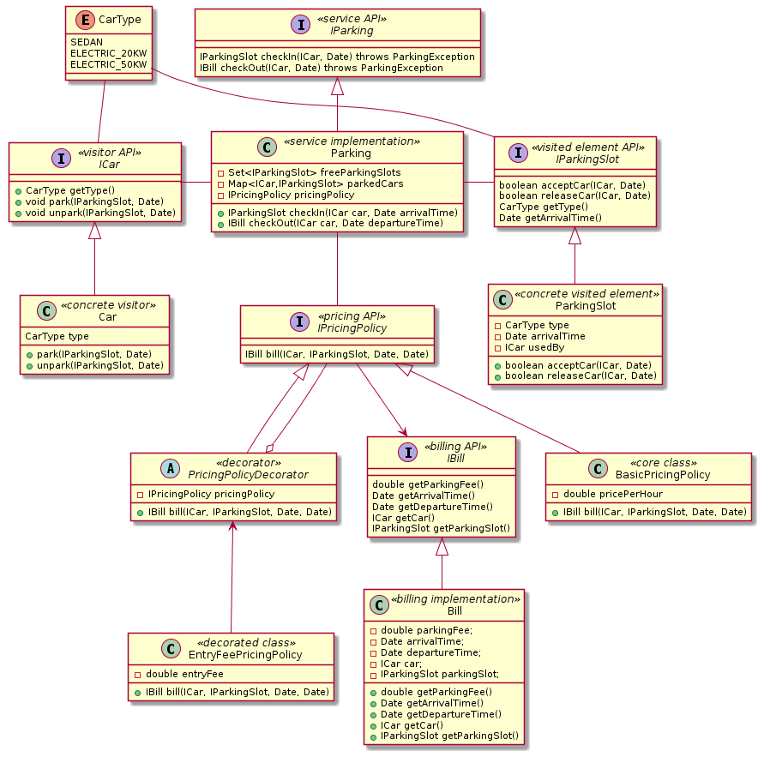
Class Diagram
No need to implement several ICar and IParkingSlot objects as they are directly bounded by the CarType enum.
Visitor Pattern allows to ICar and IParkingSlot hierarchies to be extensible without changing the API.
Decorator Pattern is used for IPricingPolicy so that new pricing policy implementations can be added by reusing the existing ones.

Slide 5
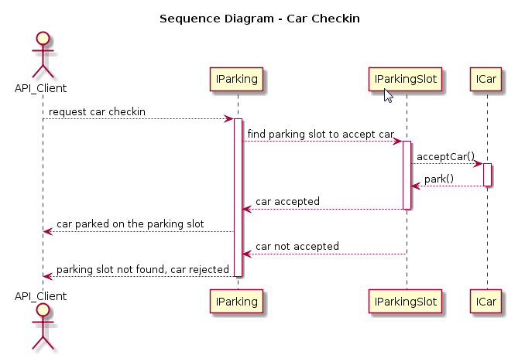
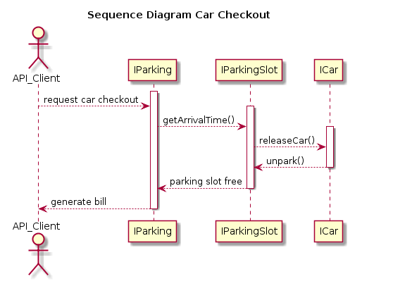
Sequence diagrams

Slide 6
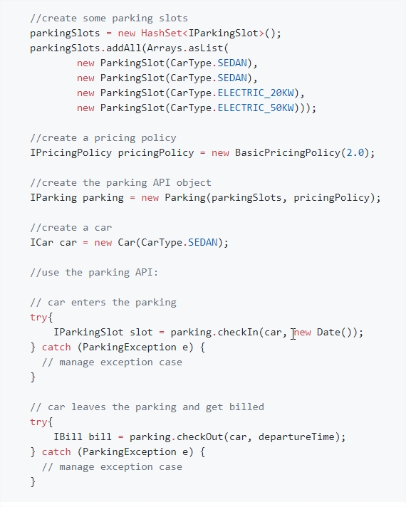
API Usage:
The API clients should first create the parking object, populate it with parking slots and choose a pricing policy.
Then create car objects.
Object creation part can be wrapped into Factory classes or a Builder object.
The parking object provides the two external methods for the cars entering and leaving the parking.
The parking provide to the API clients the parking slot to park on and the billing information when the car leaves.

Slide 7
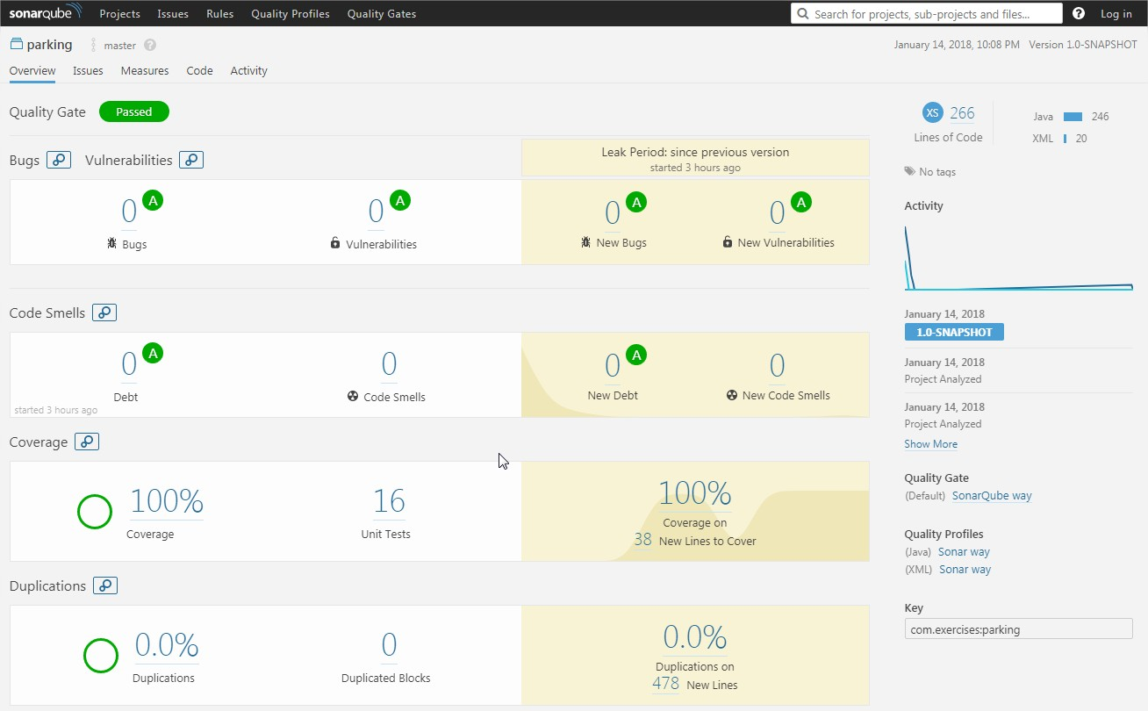
Quality results

Slide 8
Improvements
Factory or Builder to create API objects
Decouple ICar and IParkingSlot from the CarType enum by creating specific subclasses and implement the corresponding visitor methods.
Create a more easy to use Client class to demonstrate the usage of the API, instead of unit test class.
Add more “real life” fields to the API objects like plate, parking slot number
Create bill receipt from Bill object contents.
Add logging.

Slide 9
Thank you
☞ github

